Slide 1
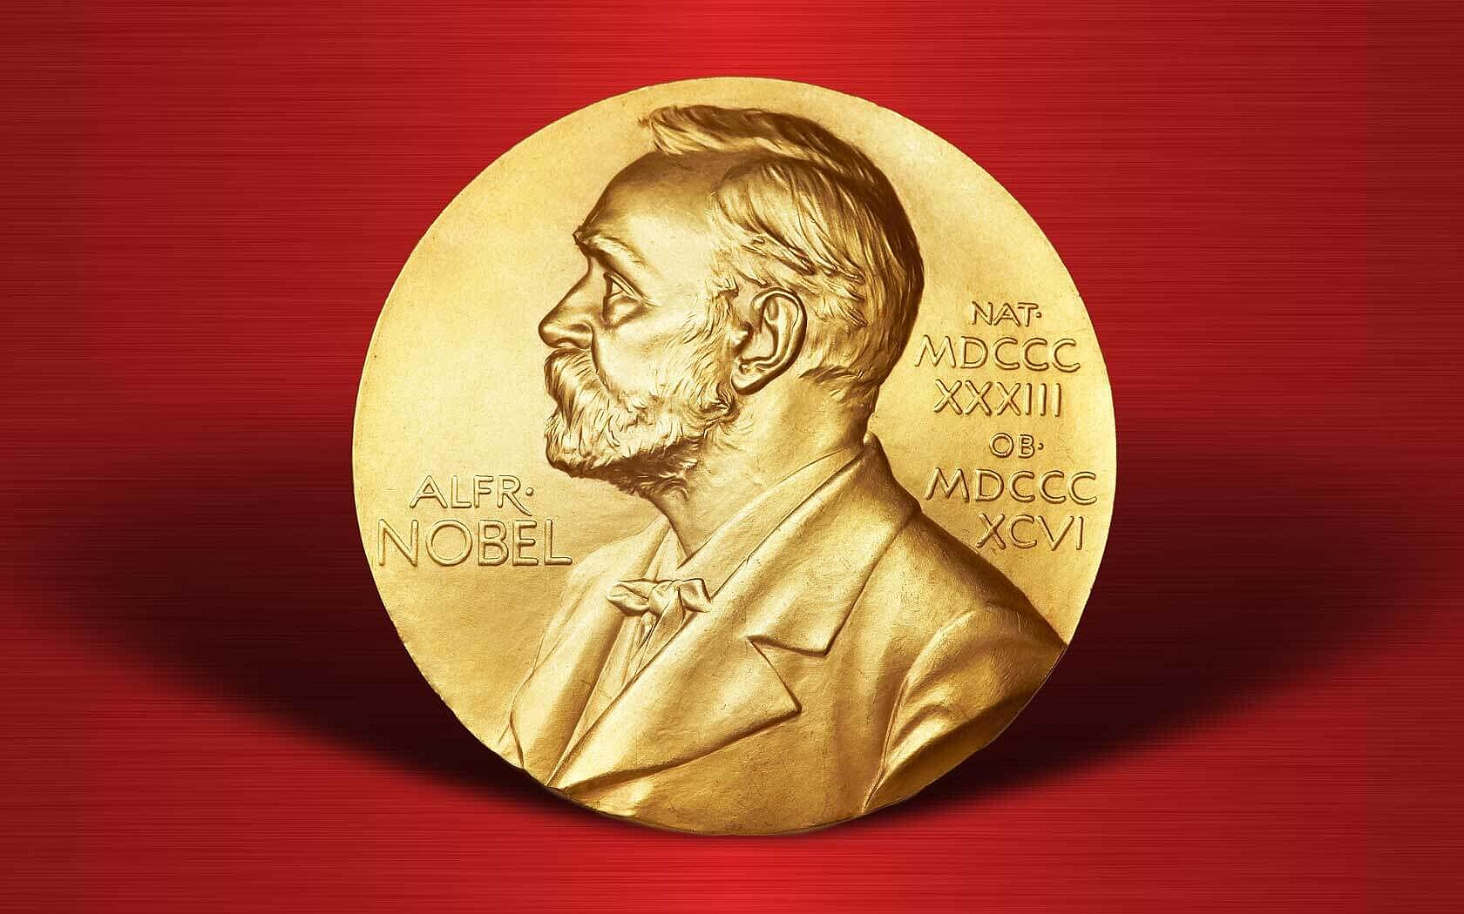

Slide 3
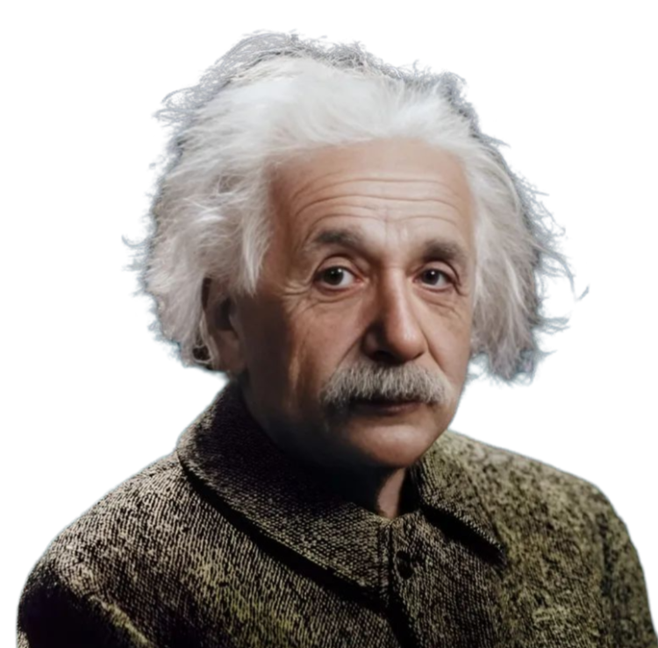
ALBERT EINSTEIN

Slide 4
ALBERT EINSTEIN
Albert Einstein
Albert Einstein (1921)
Einstein's Nobel Prize wasn't for his famous Theory of Relativity but for his work on the photoelectric effect, which demonstrated how light can be understood as particles (quanta or photons). This discovery was key to the development of quantum physics.

Slide 5
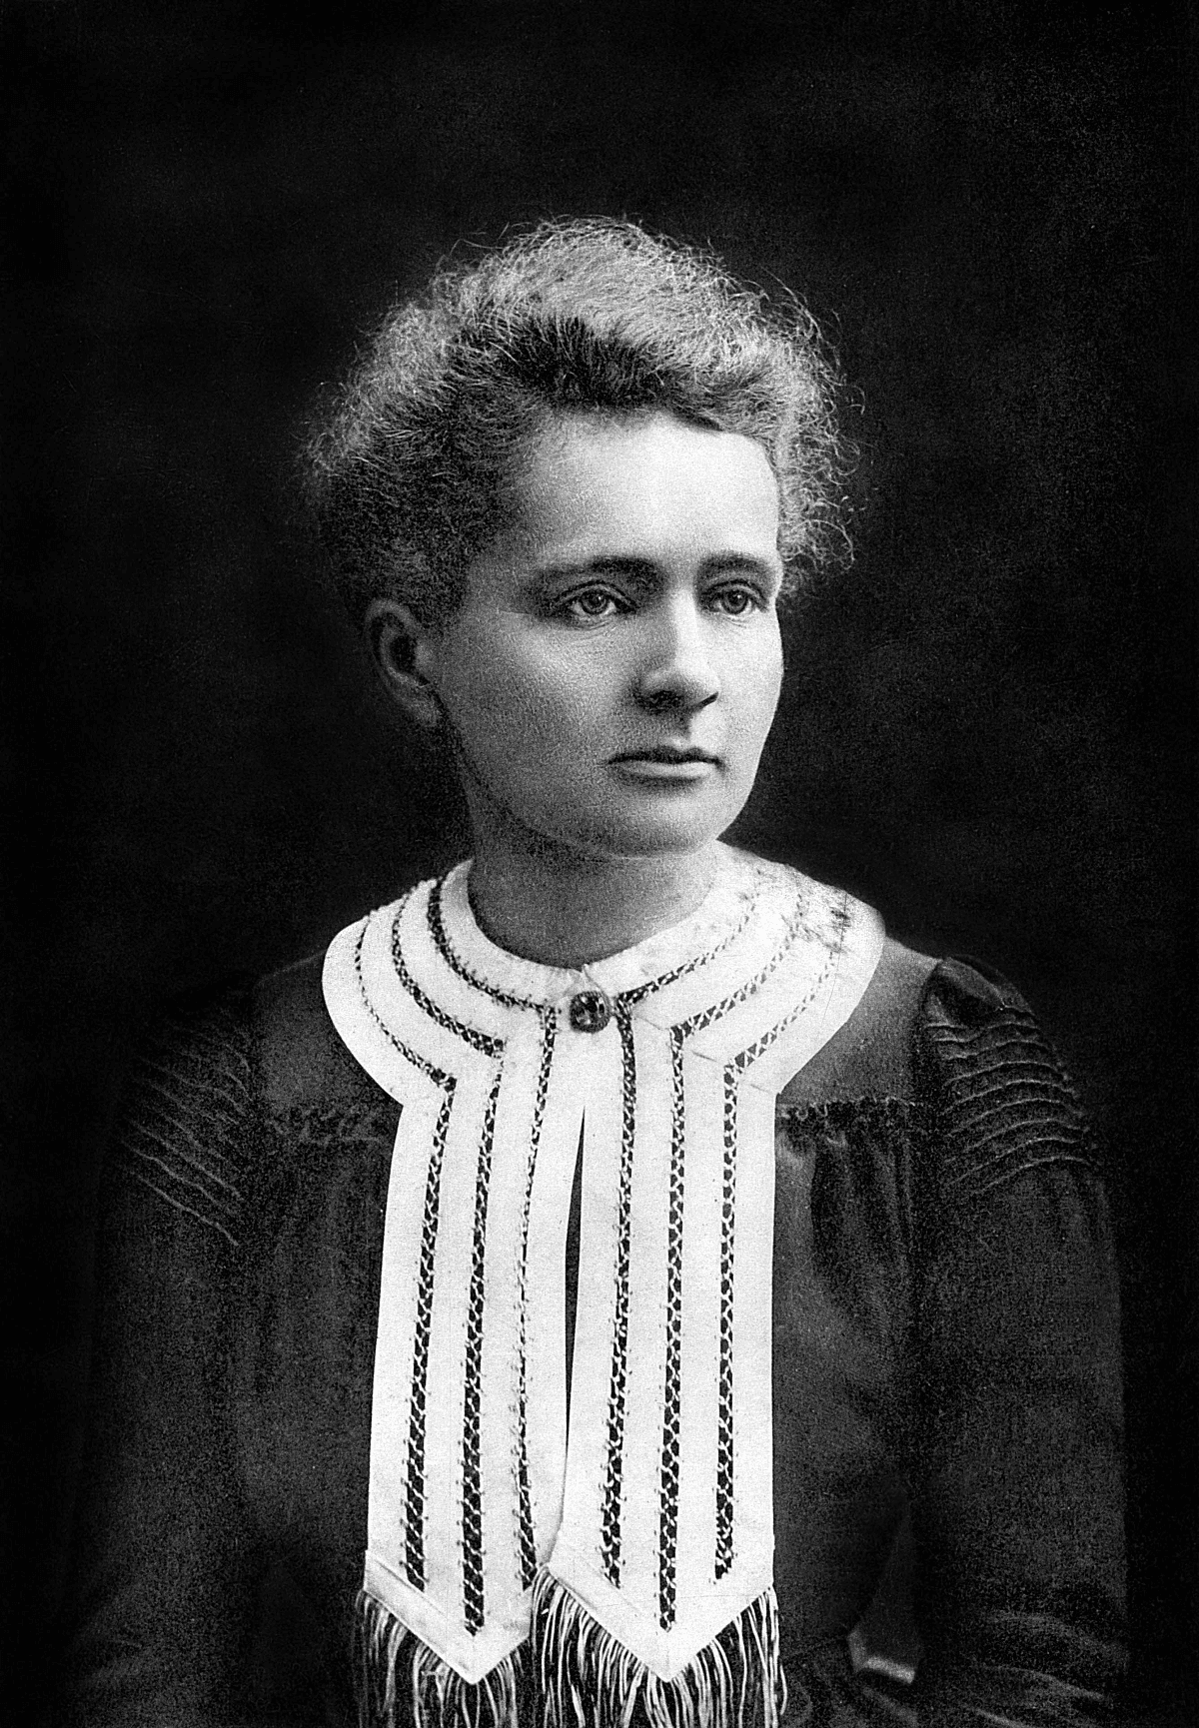
MARIE CURIE

Slide 6
MARIE CURIE
Marie curie
Marie Curie (1903)
She shared the prize with her husband, Pierre Curie, and Henri Becquerel for their work on radioactivity, a term she coined. Her research helped lay the foundation for the use of X-rays in medicine. In 1911, she won a second Nobel Prize in Chemistry for discovering the elements radium and polonium.

Slide 7
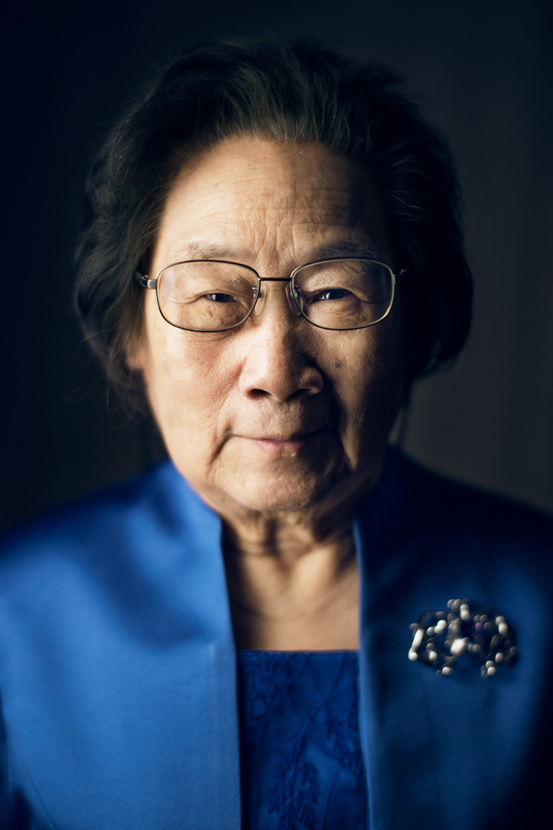
TU YOUYOU

Slide 8
TU YOUYOU
Tu Youyou
Tu Youyou (2015)
Tu discovered artemisinin, a drug derived from sweet wormwood, which became a lifesaving treatment for malaria. She based her work on traditional Chinese medicine, bridging ancient practices with modern science.

